Slide 1
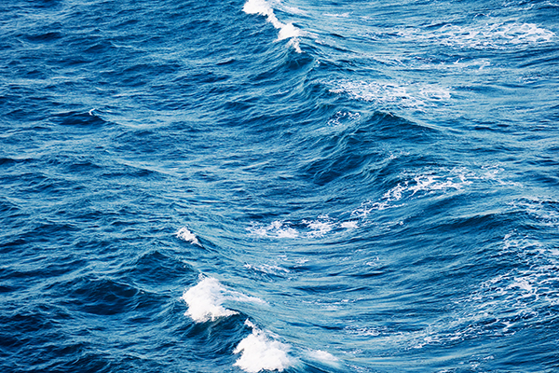
Marine Energy
Notes:
r

Slide 3
What does it mean?
Marine energy, also known as ocean energy, is a renewable source of energy
Wave-, tidal-, salinity-, offshore wind - and thermal energy
these energy sources are mostly caused by sun, moon or wind
can be generated from oceans, seas and rivers
Target is to reduce greenhouse gas

Slide 4
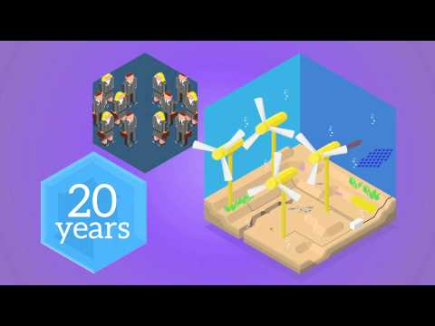

Slide 5
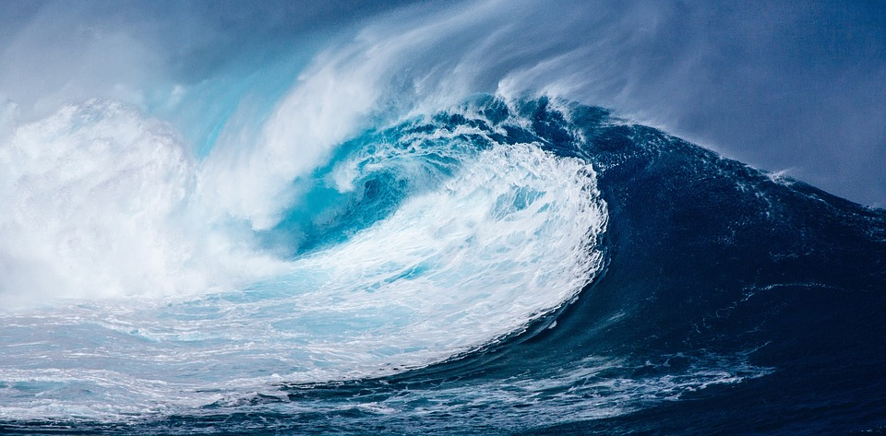
WAVE ENERGY

Slide 6
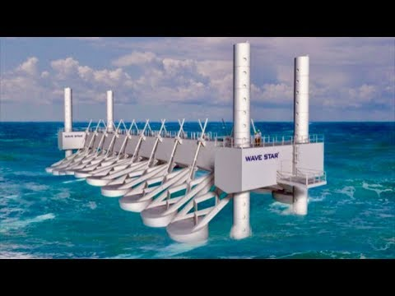

Slide 7
Wave energy
Waves caused by wind
creates kinetic energy
Still on a developmental phase
The oceans have incredibly big energy potential
United Kingdom is the leader researching and developing wave energy
Best area to collect wave energy in Europe is the Western coast.
Big waves, strong wind

Slide 8
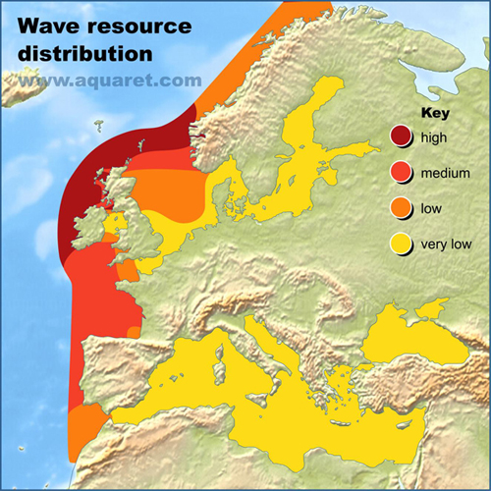
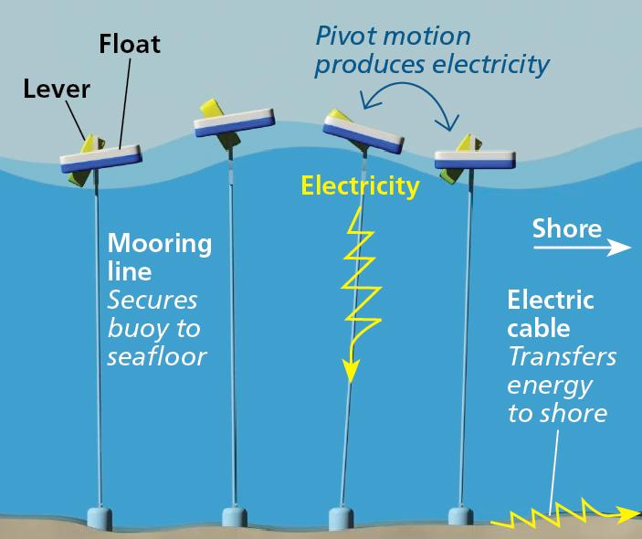

Slide 9
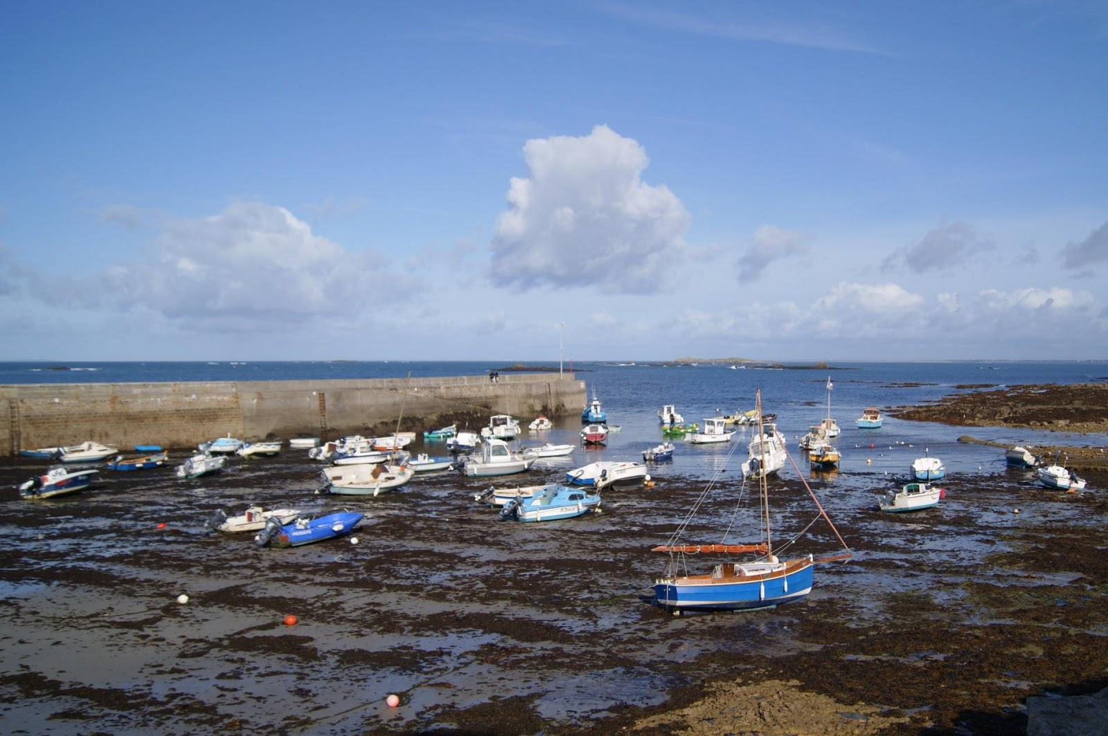
TIDAL ENERGY

Slide 10
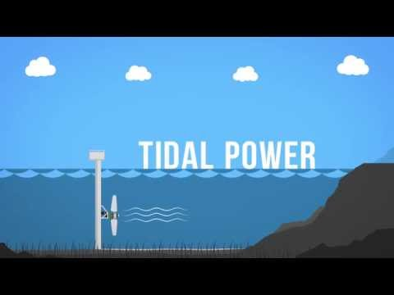

Slide 11
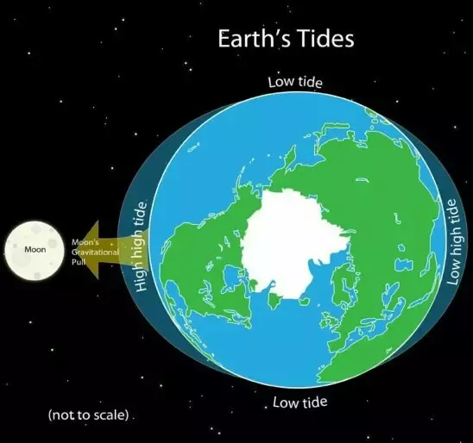
Form of hydropower that is caused specifically by gravity of the moon.
Based on Earths, moons and suns together produced tides, that cause decreasing and increasing of the water levels.
Converts the energy obtained from tides to a useful form of power → electricity.
Has potential for future electricity generations, but is still in the stage of development. Problems that limit the use of tidal energy are it’s high costs and limited availability of locations with high tidal ranges and flow velocities.
Tidal energy is predictable, which makes it a valuable resource.

Slide 12
Tidal stream resources are largest on areas that have good tidal flows.
Britain is a great example of an area, where the speed of currents also strenghten by the local coastline and seabed.
Tidal is one of the strongest in the UK:s coasts, because of the english channel. The streams and the forms of the coast cause a phenomenon, where the water level increases massively.

Slide 13
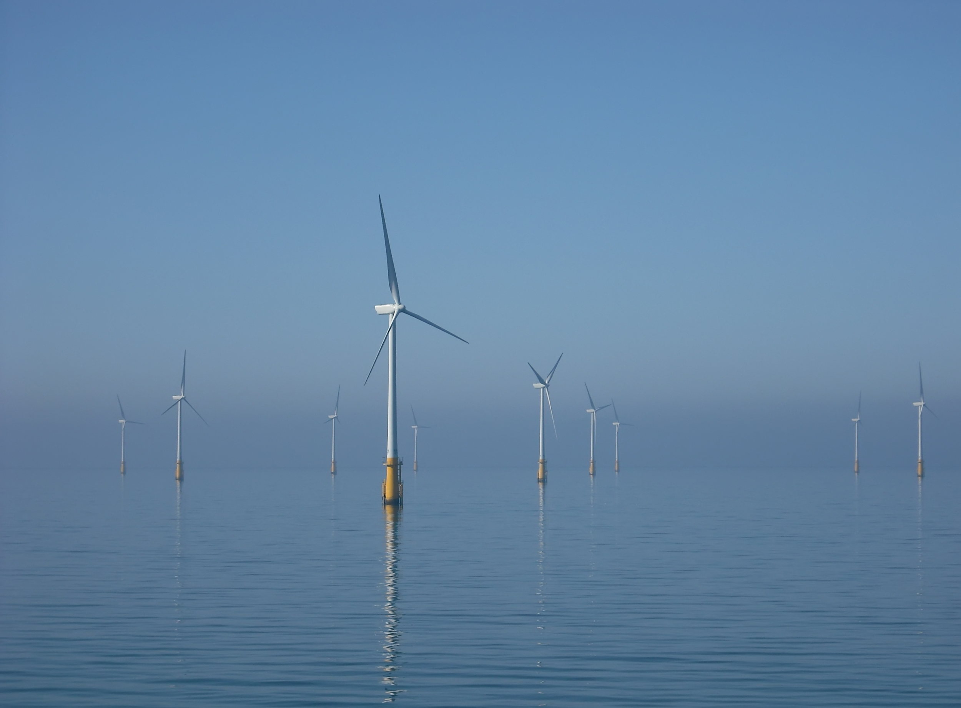
WIND ENERGY

Slide 14
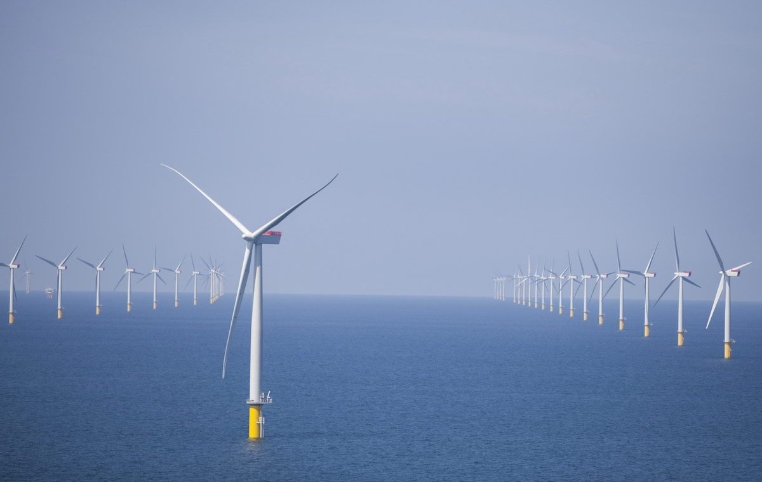
Wind energy (offshore)
in the Blue Economy it is the fastest growing activity
More expensive to build and fix than wind turbines on land
On the other hand wind turbines are more effective at sea (it’s windier at sea)
Denmark, UK and Netherlands are the biggest producers of the offshore wind energy in Europe

Slide 15
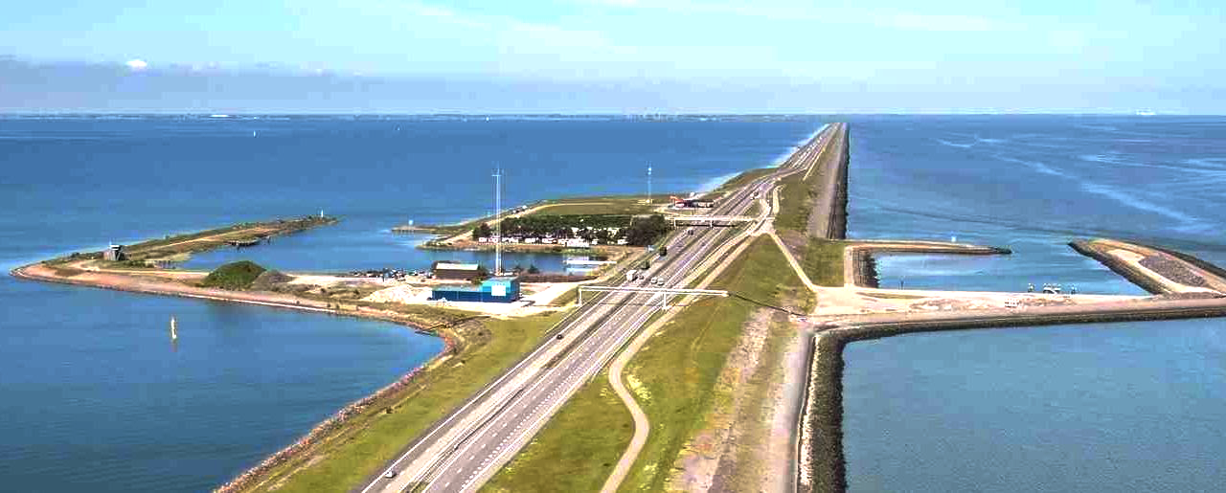
SALINITY GRADIENT ENERGY

Slide 16
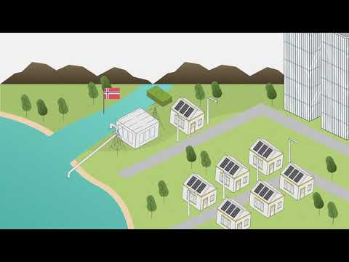
kohtaan 1:42 asti

Slide 17
Salinity gradient energy
There are two methods to get salinity energy:
Pressure retarded osmosis (PRO): the pressure caused by osmosis can be used to generate marine energy.
Two tanks are filled with seawater and fresh water. A diffusion is causing pressure to one of the tanks through permeable membrane.
Salinity energy is in development phase
The biggest obstacle is the membrane causing lot of money and being still developed.
Leading countries developing salinity energy are Norway and the Netherlands.
Reverse electro dialysis (RED): Membranes used between anode and cathode, half permeable for sodium and half for chloride, allows the ions to float alternatively between the anode and cathode which generates energy.

Slide 19
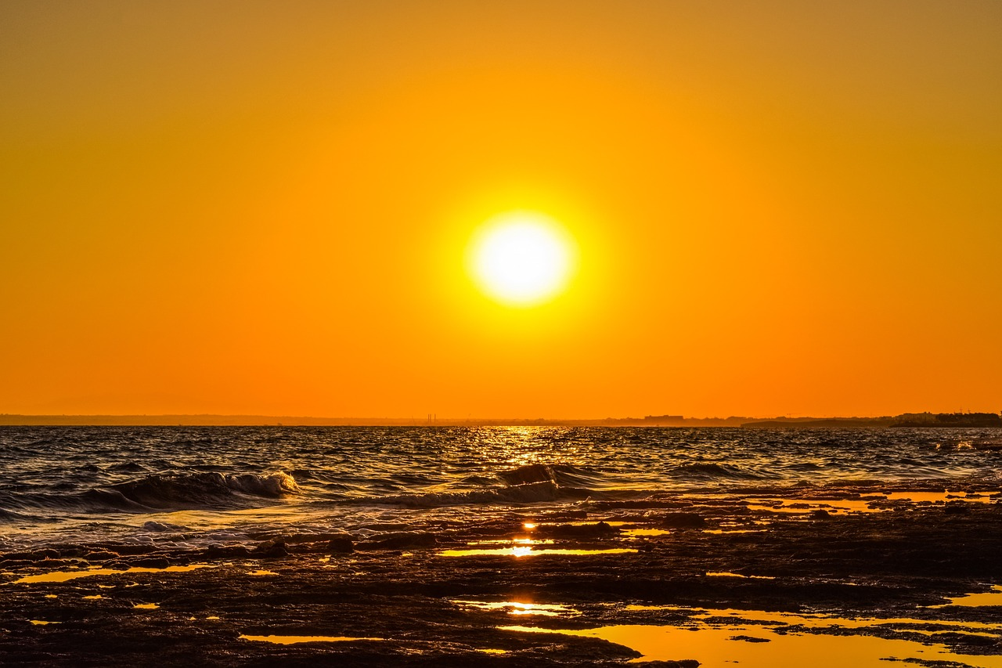
THERMAL ENERGY

Slide 20
Thermal energy
= Ocean Thermal Energy Conversion (OTEC)
Energy is produced by using the temperature differences (=thermal gradients) between ocean surface water and deep ocean water
Provides steady power 24/7 & year-round without energy storages
The global resource of OTEC could produce 4X humanity’s electrical needs
1 OTEC plant is able to prevent burning 1.3M barrels of oils per year
1 OTEC plant could also prevent CO₂ emissions of over 0.5M tons each year (which means the same than over 100K cars)

Slide 21
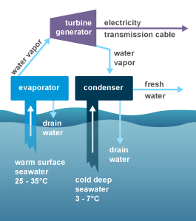
Energy from the sun heats the surface water
Warm surface water is pumped through an evaporator containing a working fluid
The vaporized fluid drives a turbine which produces electricity
The fluid is turned back to liquid in a condenser
The fluid cools with cold water pumped from deeper in the ocean
The condenser can also produce desalinated water

Slide 22
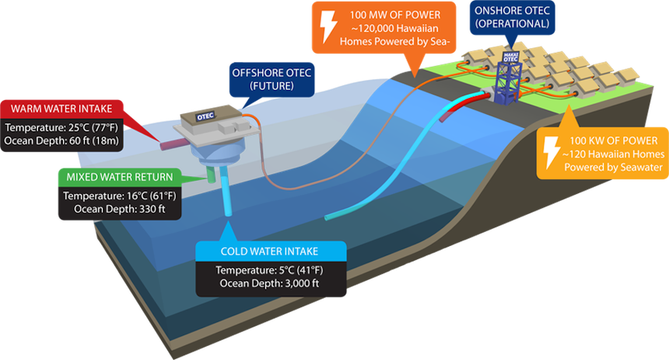

Slide 23
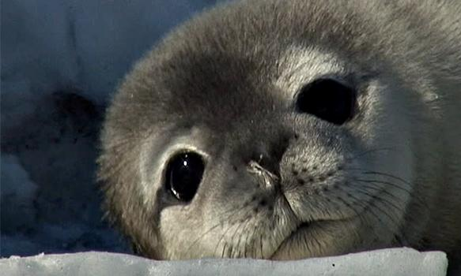
The challenges of marine energy
unpredictability
new form of energy → may encourage
may disturb water animals
Expensive to build

Slide 24
All in all...
marine energy
is a green form of energy
could raise the economic growth
would create more jobs
can be combined with other renewable energy sources

Slide 25
Sources
https://www.quora.com/What-is-the-moon-role-in-tidal-energy (read: 20.3.2019)
https://www.oceanenergy-europe.eu/ocean-energy/ (read 20.3.2019)
http://www.aquaret.com/images/stories/aquaret/wave-600.jpg
https://www.youtube.com/watch?v=Yt7uxwiFcMw - video (read: 20.3.2019)
https://www.youtube.com/watch?v=VkTRcTyDSyk -video/tidal energy (read: 20.3.2019)
http://1.bp.blogspot.com/-nyb-Kwm0ZDo/UZz_mHfeaLI/AAAAAAAAHiY/eJBhS2xbrCQ/s1600/vuorovesi.jpg -photo/tidal(read: 20.3.2019)
https://cdn.pixabay.com/photo/2016/12/17/14/33/wave-1913559_960_720.jpg -picture/waves (read:20.3.2019)
https://upload.wikimedia.org/wikipedia/commons/a/a7/Barrow_Offshore_wind_turbines_NR.jpg - piture/wind energy (read:20.3.2019)
https://www.youtube.com/watch?v=m7ImT4CdcPo - video/ tidal energy (read:20.3.2019)
https://www.climatetechwiki.org/technology/jiqweb-ro
https://www.makai.com/ocean-thermal-energy-conversion/
https://www.eia.gov/energyexplained/index.php?page=hydropower_ocean_thermal_energy_conversion
Blue Growth -Study Guide

